Slide 1
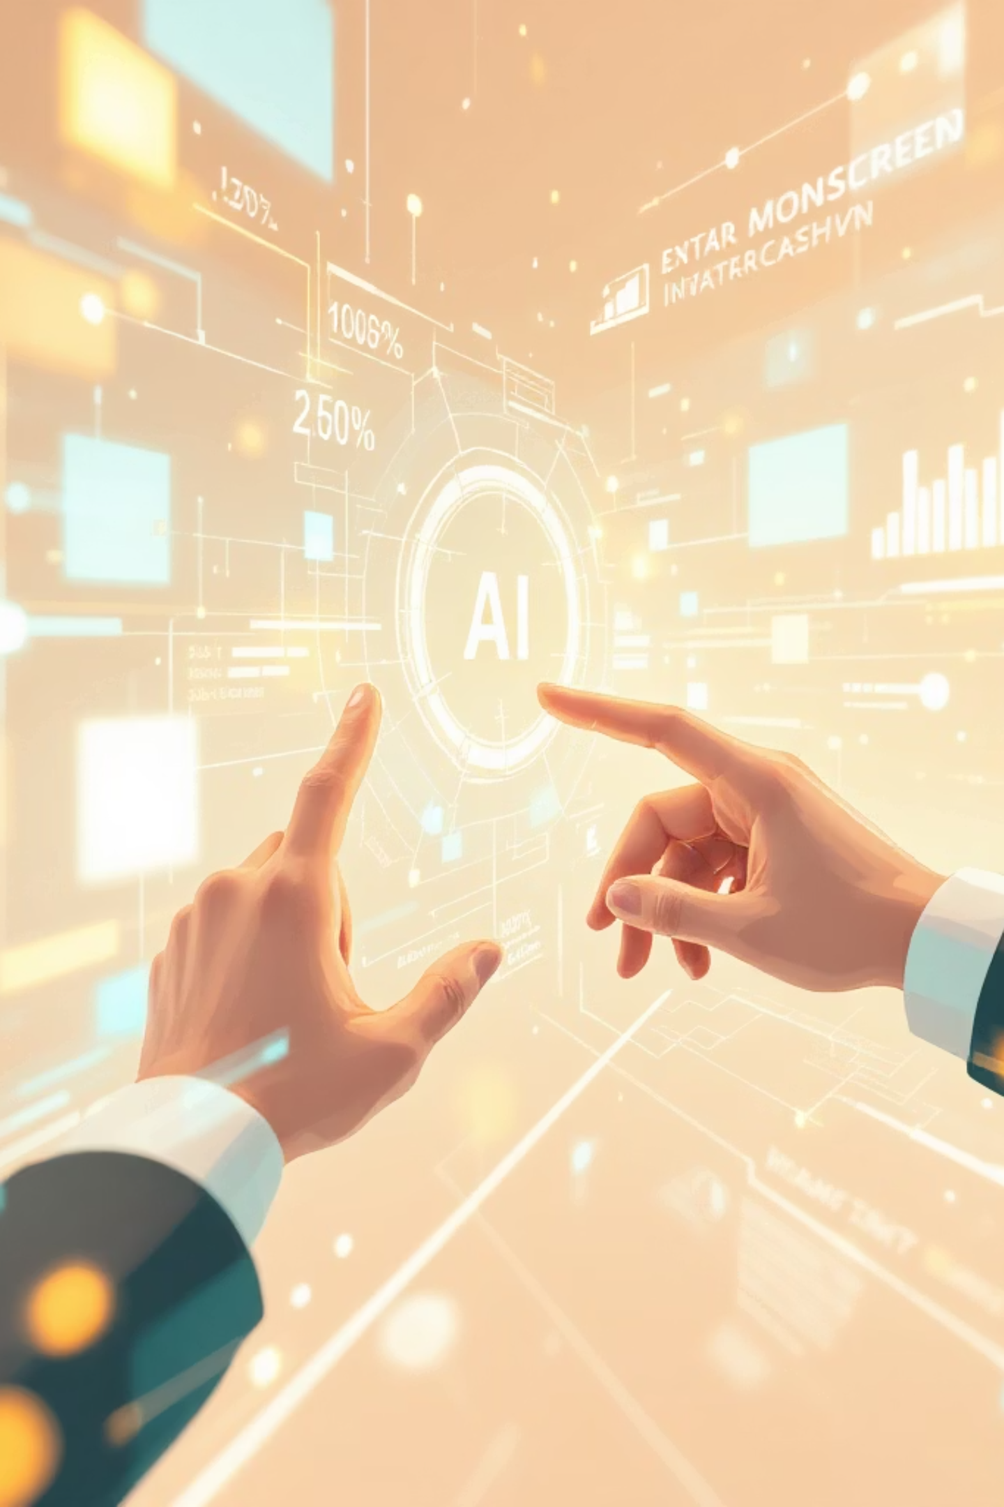
Mastering AI Prompting: Business, Marketing & SEO
Unlock the power of AI for real-world applications in branding, content generation, and lead conversion. This module equips business professionals, marketers, and SEO practitioners with job-ready AI prompting skills.

Slide 2
MODULE OBJECTIVES
Your Journey to AI Prompting Mastery
01
02
Business Use Cases
Brand Messaging & Content
Learn to leverage AI prompts for practical, real-world business scenarios.
Build strong brand identities and generate compelling marketing, SEO, and sales content.
03
04
Content Optimization
High-Converting Assets
Master rewriting and optimizing content for clarity, impact, and search engine visibility.
Create effective emails, ads, and lead magnets that drive conversions and engagement.

Slide 3

Chapter 1
AI Prompts for Powerful Branding
Branding is the soul of your business – it's how your audience perceives your voice, tone, values, and overall identity. AI acts as your strategic partner in defining and refining these crucial elements, ensuring consistency and impact.
Teaching Tip:
When crafting branding prompts, always specify:
Target audience
Industry context
Desired brand tone (e.g., formal, fun, bold, premium)
Define distinctive brand voice
Generate compelling taglines & slogans
Craft inspiring mission & vision statements
Develop a unique brand personality

Slide 4

BRANDING EXAMPLES
Crafting Your Brand Narrative with AI
Brand Identity
Tagline Creation
Brand Voice
"Act as a branding expert. Create a brand identity for a startup that provides AI-based education for college students. Include tone, values, and personality."
"Generate 10 catchy taglines for a fitness app focused on busy professionals."
"Define a brand voice that is professional, friendly, and tech-savvy for a SaaS product."
These prompts are designed to elicit specific, actionable outputs from AI, helping you build a cohesive and impactful brand presence from the ground up.

Slide 5

Chapter 2
AI for Dynamic Marketing Campaigns
Effective marketing is about attracting the right customers, communicating your unique value, and driving them to take action. AI can significantly streamline and enhance these processes, providing creative ideas and efficient content generation.
Teaching Tip:
For impactful marketing prompts, always include:
Specific platform (e.g., Instagram, LinkedIn, Email)
Clear goal (e.g., sales, awareness, engagement)
Defined target audience
Brainstorm innovative campaign ideas
Generate engaging social media posts
Write compelling product descriptions
Develop comprehensive marketing strategies

Slide 6
MARKETING EXAMPLES
AI-Powered Marketing: From Strategy to Social
Marketing Strategy
Social Media Content
Product Marketing
"Create a 30-day marketing plan for an online coding course targeting beginners."
"Generate 7 Instagram post ideas to promote a new skincare brand."
"Write a compelling product description for wireless earbuds under $200."
These examples demonstrate how AI can assist in various marketing functions, from high-level strategic planning to granular content creation, ensuring your message resonates with your audience.

Slide 7

Chapter 3
Supercharging SEO with AI Prompts
Search Engine Optimization (SEO) is critical for driving free, organic traffic to your content. By leveraging AI, you can elevate your search rankings and visibility, making sure your target audience finds you easily.
Teaching Tip:
When prompting for SEO, utilize terms like:
SEO-optimized: For content designed for search engines.
Search intent: To align with user queries.
Long-tail keywords: For niche targeting.
Headings (H1, H2): For structured content.
Conduct efficient keyword research
Generate SEO-optimized blog content
Craft compelling meta titles & descriptions
Enhance existing content for better ranking

Slide 8
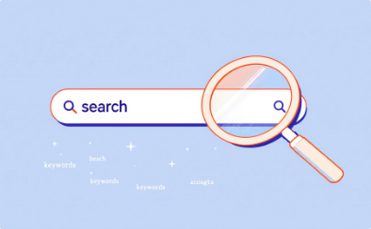

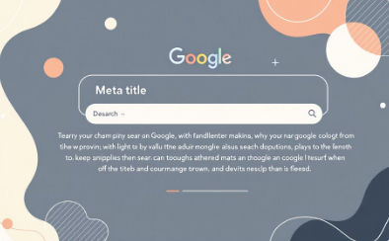
SEO EXAMPLES
AI for Enhanced Search Visibility
Keyword Research
SEO Blog Writing
Meta Tags
"Generate an SEO-friendly meta title and description for an article on digital marketing."
"Find low-competition SEO keywords for a blog on Python for beginners."
"Write an SEO-optimized blog on 'Best Programming Languages in 2025' with headings and FAQs."
These prompts illustrate AI's capability to assist in various SEO tasks, helping you improve your content's discoverability and performance on search engines.

Slide 9

Chapter 4
AI for Effective Email Communication
Emails remain a cornerstone of business communication, from marketing campaigns to sales outreach. AI empowers you to write clear, persuasive, and professional emails that resonate with your recipients and drive desired actions.
Teaching Tip:
When prompting for emails, specify:
The email's core purpose
Desired tone (e.g., formal, friendly, urgent)
A clear Call to Action (CTA)
Craft impactful marketing and sales emails
Generate engaging cold emails and follow-ups
Develop compelling newsletters
Ensure professional and clear communication

Slide 10
EMAIL EXAMPLES
Automating Your Email Outreach with AI
Cold Email
Marketing Email
Follow-up Email
"Write a cold email pitching web development services to small businesses. Keep it short and professional."
"Create a promotional email for a Diwali sale with urgency and CTA."
"Write a polite follow-up email after no response for 7 days."
These examples demonstrate how AI can help you compose various types of emails, saving time and ensuring your messages are always on point and effective.

